Slide 1

Whale Population Tracking
David C. Bill
University of Washington Bothell
BME 450A
13 March 2019

Slide 2
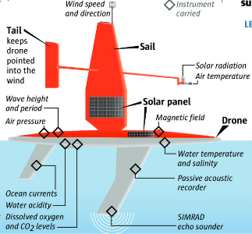
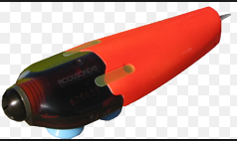
Traditional Methods used
Satellite Data
Aerial Surveys (sighting)
Issues:
Dynamic whale movement
Ineffective at depths (can dive to 10,000 ft)
How can they distinguish one whale from another?
Use of Saildrones by NOAA
Unmanned, easily deployed
Range: 16,000 nautical miles
Uses wind and solar power
Data streamed to shore via satellite
Use of Acousonde
Filtered to show types of species
Notes:
Can track a variety of parameters: Flourometer, wind, temperature, salinity
More specific: How do they track species? Bounces soundwaves off the backs of marine life species. This records the abundance of each type of marine life in that vicinity. Can be programmed to track a cartain species, or follow one individual whale via an app on an i-phone.
https://ferret.pmel.noaa.gov/pmel/erddap/info/saildrone_west_coast_survey_2018/index.html

Slide 3
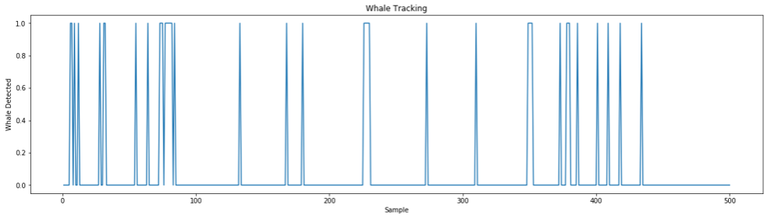
Whale Population Tracking
Train excel spreadsheet
https://drive.google.com/open?id=1gc7I6GjH2atkjPCsfS2al73btLgVgTTd
Example from Kaggle is similar to the whale calls on the project
1 = whale call
0 = non whale call
Jupyter graph printout shows whale presence vs non whale presence per sampling
Notes:
https://www.kaggle.com/c/whale-detection-challenge/data
Spectogram and plot analysis difficult to discern whale call from ocean noise.
The actual sample size was 30,000. For the Jupyter programming, I truncated it at 500 to make the graph easier to read.

Slide 4
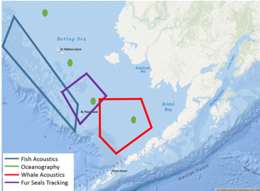
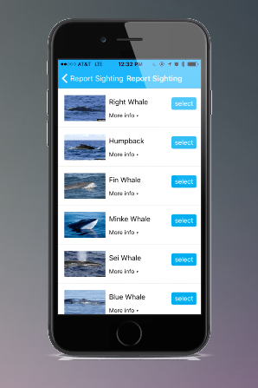
Conclusion
Can be programmed to track via I - phone
Weather forecasts
CO2, Salinity/ Sea Temp
Oil spills
Fish biomass/Marine life
Bounces waves off back of species
Clues from listening to sounds
Average # detected over time
Mission focused on known population densities
95% certainty
Data from sea bed sensors (OBS)
Sea traffic monitoring
Bathymetry (depths) for safe navigation
Notes:
http://www.whalealert.org/
https://www.saildrone.com/missions
https://www.fisheries.noaa.gov/feature-story/tracking-technology-science-finding-whales

